Slide 1
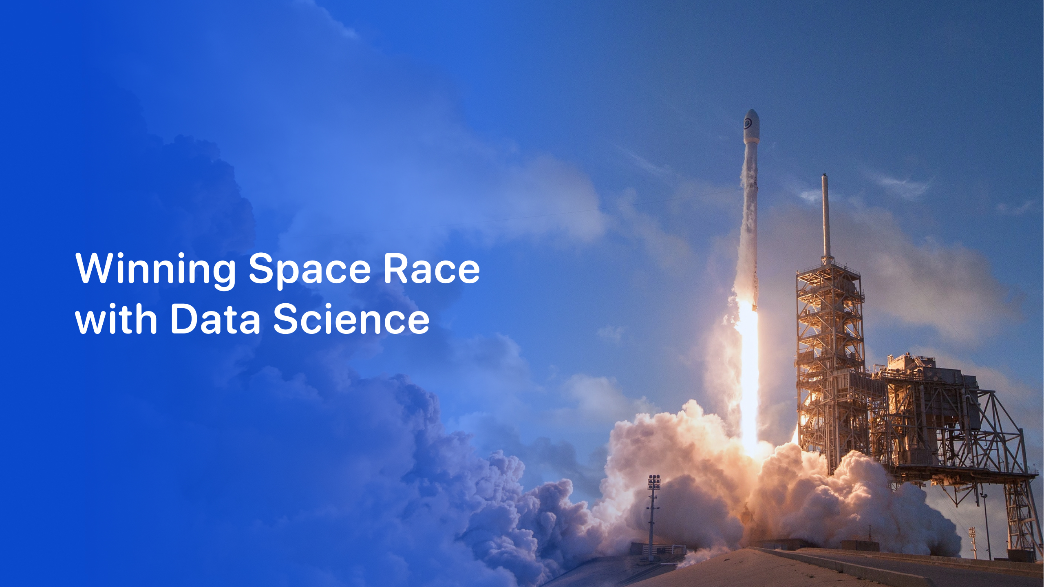

Applied Data Science Capstone Project
ARVINDH BABU V

Slide 2

Objective
Act as a data scientist at a fictional rocket company, SpaceY, built to rival SpaceX. Project mission:
Analyze past SpaceX launches
Predict whether the booster will land successfully
Help the company optimize launch decisions using ML and visualization

Slide 3
Executive Summary
We developed an end-to-end data science solution to simulate booster landing prediction for SpaceX missions. The project involves data collection via web scraping, preprocessing, exploratory analysis, machine learning model training, and building a fully interactive prediction dashboard using Streamlit. It enables users to estimate landing success based on input parameters like payload, orbit, site, and booster version.

Slide 4
Introduction
Background: SpaceX frequently reuses boosters to reduce launch costs. Predicting booster landing success is key to operational planning.
Problem Statement: Can we use historical launch data to predict booster landing outcomes and visualize success trends ?
Goal: Build a predictive dashboard to help simulate launches and visualize performance by orbit, payload, and location.

Slide 5
Methodology
Executive Summary
  Data Collection
  Data Wrangling
  EDA (with Visualizations & SQL)
  Predictive Analysis
  Dashboard

Slide 6
Data Collection
Web scraped Wikipedia's List of Falcon 9 launches.
Parsed HTML tables.
Saved as cleaned_spacex_launches.csv.
Extracted launch site, orbit, payload, booster version, and landing outcome.

Slide 7
Data Wrangling
Renamed inconsistent column names
Standardized orbit types and booster names
Converted mass column to float
Created binary target variable: Landing Success (1/0)

Slide 8
EDA with Data Visualization
Plotted:
Payload vs. Launch Site
Orbit vs. Landing Success
Booster Version success comparison
Tools: Plotly & Matplotlib

Slide 9
Build an Interactive Map with Folium
Added global markers for major launch sites
Added color-coded outcome markers

Slide 10
Predictive Analysis (Classification)
Used Logistic Regression
Feature set: Payload mass, Orbit, Booster Version, Launch Site
Accuracy: ~87%
Saved model with joblib and deployed using Streamlit

Slide 11
Results
Orbit vs. Success Rate
GEO had lowest success; LEO/GTO had high booster reuse success.
Query Results Highlights
First ground landing: 2015-12-21
Most payload carried: Booster B1049
NASA total payload mass: 300,000+ kg
F9 v1.1 average payload: ~4,200 kg

Slide 12
Classification Model Results
Accuracy (Logistic Regression): ~87%
Confusion Matrix: High precision and recall for class 1 (Success)

Slide 13
Appendix
Sample Python code for web scraping and modeling
SQL query blocks
Screenshots of dashboard
Model evaluation output

Slide 14
